Slide 1

CSE 3521: Introduction to Artificial Intelligence
[Many slides are adapted from the UC Berkeley. CS188 Intro to AI at UC Berkeley and previous CSE 3521 course at OSU.]

Slide 2
Final Exam Format
60 minutes
Available for 24 hrs
i.e, you can take it anytime during the day
Carman Quiz
Mixed format: MCQ, T/F, fill-in-the-blanks, ….
If you need any special accommodation email me ASAP
tabassum.13@osu.edu

Slide 3
PEAS

Slide 4
PEAS
Performance – measuring the agent’s success
Environment – what populates the problem’s world?
Actuators – what can the agent act with?
Sensors – how can the agent perceive the world?

Slide 5
Peas: Examples
Agent Type | Perf. Measure | Environment | Actuators | Sensors
Medical diagnosis system | Healthy patient, minimize costs/lawsuits | Patient, hospital, staff | Display questions, tests, diagnoses, treatments, referrals | Keyboard entry of symptoms, findings, patient’s answers
Satellite image analysis system | Correct image classification | Downlink from orbiting satellite | Display classification of scene | Color pixel arrays (cameras)
Part-picking robot | Percentage of parts in correct bins | Conveyor belt with parts, bins | Jointed arm and hand | Camera, joint angle sensors
Refinery controller | Maximize purity, yield, safety | Refinery, operators | Valves, pumps, heaters, displays | Temperature, pressure, chemical sensors
Interactive English tutor | Maximize student’s score on test | Set of students, testing agency | Display exercises, suggestions, corrections | Keyboard entry

Slide 6
Rational Agent

Slide 7
What makes an AI agent
Agent – an entity that perceives its environment through sensors, and acts on it with effectors (actuators).
Percepts are constrained by Sensors + Environment
Actions are constrained by Actuators + Environment
Sensors
Actuators
Percepts
Actions
Agent
?
Environment
Agent Function (policy) – how does it choose the action?

Slide 8
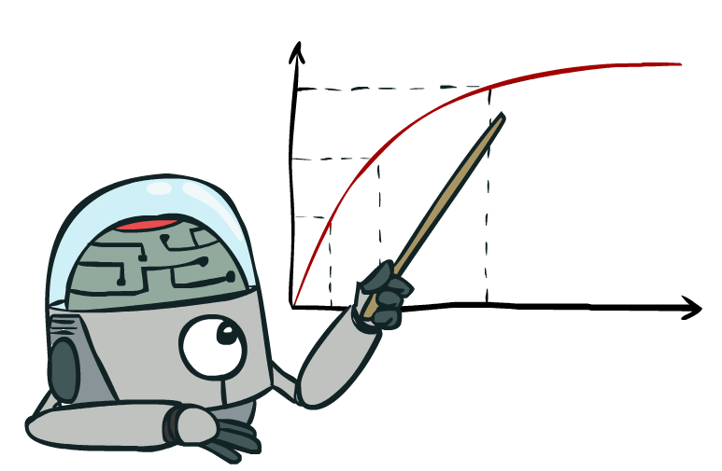
What is a rational AI agent?
A rational agent always acts to maximize its expected performance measure, given current percept/state
Rationality ≠ omniscience
There is “uncertainty” in the environment.
That is why we emphasize “expected”.

Slide 9
Kinds of Environments
Six common properties to distinguish environments (not exhaustive)
Fully observable vs Partially observable
Single agent vs Multiagent
Deterministic vs Stochastic
Episodic vs Sequential
Static vs Dynamic
Discrete vs Continuous

Slide 10
Examples
 | Crossword puzzle | Taxi Driving
Observability
Deterministic vs Stochastic
Episodic vs Sequential
Static vs Dynamic
Discrete vs Continuous
Single vs Multi Agent
Fully
Deterministic
Sequential
Static
Discrete
Single
Partially
Stochastic
Sequential
Dynamic
Continuous
Multi

Slide 11
Search

Slide 12
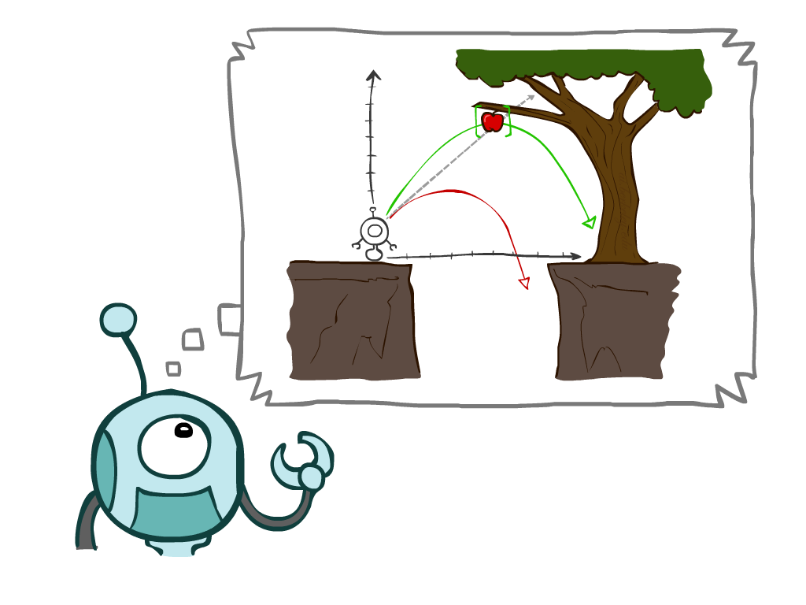
Search
Types
Uninformed Search Methods
Depth-First Search
Breadth-First Search
Uniform-Cost Search
Informed Search Methods
Greedy Search
A* Search
Notes:
General theme in the class:
A goal we have in mind.
A mathematical abstraction to formalize this
Algorithms that operate on these abstractions

Slide 13
Search Problems
A search problem consists of:
A state space
A successor function
(with actions, costs)
A start state and a goal test
A solution is a sequence of actions (a plan) which transforms the start state to a goal state

Slide 14
Depth-First Search
a
G
a
Strategy: expand a deepest node first
Implementation: Fringe is a LIFO stack
c
b
c
b
e
d
e
d
f
f
S
h
h
p
p
r
q
r
q
S
d
e
p
b
c
e
h
r
q
a
a
h
r
p
q
f
p
q
f
q
c
G
q
c
G
a
a

Slide 15
Breadth-First Search
Strategy: expand a shallowest node first
Implementation: Fringe is a FIFO queue
a
G
b
c
d
e
f
S
h
p
q
r
S
d
e
p
Search
Tiers
b
c
e
h
r
q
a
a
h
r
p
q
f
p
q
f
q
c
G
q
c
G
a
a

Slide 16
Iterative Deepening Search
Idea: get DFS’s space advantage with BFS’s time / shallow-solution advantages
Run a DFS with depth limit 1. If no solution…
Run a DFS with depth limit 2. If no solution…
Run a DFS with depth limit 3. …..
Isn’t that wastefully redundant?
Generally most work happens in the lowest level searched, so not so bad!
A Preferred method with large search space and depth of solution not known
b
…

Slide 17
Uniform Cost Search (USC)
2
G
a
Strategy: expand a cheapest node first:
Fringe is a priority queue (priority: cumulative cost)
b
c
1
8
2
2
e
3
d
f
9
8
2
S
h
1
1
p
q
r
15
0
S
d
3
e
9
p
1
b
4
e
5
h
17
r
11
q
16
c
11
Cost contours
a
6
a
h
13
r
7
p
q
f
p
q
f
8
q
c
G
q
c
a
11
G
10
a

Slide 18
Search Heuristics
A heuristic is
A function that estimates how close a state is to a goal
Designed for a particular search problem
Examples: Manhattan distance, Euclidean distance for pathing
not the exact “path” distance

Slide 19

Greedy Search
Expand the node that seems closest…
What can go wrong?
Does not guarantee the optimal solution

Slide 20
Greedy Search
b
Strategy: expand a node that you think is closest to a goal state
Heuristic: estimate of distance to nearest goal for each state
A common case:
Best-first takes you straight to the (wrong) goal
Worst-case: like a badly-guided DFS
…
b
…
Notes:
For any search problem, you know the goal. Now, you have an idea of how far away you are from the goal.

Slide 21

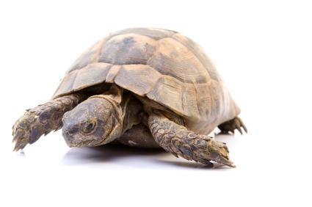
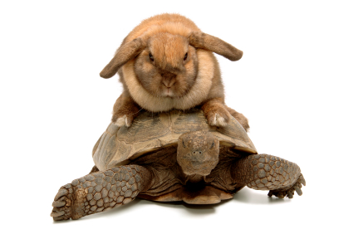
A* Search
UCS
Greedy
A*

Slide 22
A* is a Combination of UCS and Greedy
Uniform-cost orders by path cost, or backward cost g(n)
Greedy orders by goal proximity, or forward cost h(n)
A* Search orders by the sum: f(n) = g(n) + h(n)
8
g = 0 h=6
S
e
h=1
g = 1 h=5
a
1
1
3
2
g = 2 h=6
g = 9 h=1
S
a
d
G
b
d
g = 4 h=2
e
h=6
1
h=5
h=2
h=0
1
g = 3 h=7
g = 6 h=0
g = 10 h=2
c
b
c
G
d
h=7
h=6
g = 12 h=0
G

Slide 23
Propositional Logic

Slide 24
Logic
For logical agents, knowledge is definite
Each proposition is either “True” or “False”
Logic has advantage of being simple representation for knowledge-based agents
But limited in its ability to handle uncertainty
We will examine propositional logic and first-order logic

Slide 25
Logical Agent
Need agent to represent beliefs
“There is a pit in (2, 2) or (3, 1)”
“There is no Wumpus in (2, 2)”
Need to make inferences
If available information is correct, draw a conclusion that is guaranteed to be correct
Need representation and reasoning
Support the operation of knowledge-based agent

Slide 26
Knowledge Representation
For expressing knowledge in computer-tractable form
Knowledge representation language defined by
Syntax
Defines the possible well-formed configurations of sentences in the language
Semantics
Defines the “meaning” of sentences (need interpreter)
Defines the truth of a sentence in a world (or model)

Slide 27
The Language of Arithmetic
Syntax: “x + 2 ≥ y” is a sentence
“x2 + y >” is not a sentence
Semantics: x + 2 ≥ y is true iff the number x + 2 is no less than the number y
x + 2 ≥ y is True in a world where x=7, y=1
x + 2 ≥ y is False in a world where x=0, y=6

Slide 28
Inference
Sentence is valid iff it is true under all possible interpretations in all possible worlds
Also called tautologies
“There is a stench at (1,1) or there is not a stench at (1,1)”
“There is an open area in front of me” is not valid in all worlds
Sentence is satisfiable iff there is some interpretation in some world for which it is true
“There is a wumpus at (1,2)” could be true in some situation
“There is a wall in front of me and there is no wall in front of me” is unsatisfiable

Slide 29
Propositional Logic: Syntax
Syntax of propositional logic defines allowable sentences
Atomic sentences consists of a single proposition symbol
Each symbol stands for proposition that can be True or False
Symbols of propositional logic
Propositional symbols: P, Q, … (e.g., “Today is Tuesday”)
Logical constants: True, False
Making complex sentences
Logical connectives of symbols: ∧, ∨, ⇔, ⇒, ¬
Also have parentheses to enclose each sentence: (…)
Sentences will be used for inference/problem-solving

Slide 30
Propositional Logic: Syntax
True, False, S₁, S₂, … are sentences
If S is a sentence, ¬S is a sentence
Not (negation)
S₁ ∧ S₂ is a sentence, also (S₁ ∧ S₂)
And (conjunction)
S₁ ∨ S₂ is a sentence
Or (disjunction)
S₁ ⇒ S₂ is a sentence (e.g., “Today is Tuesday” implies “Tomorrow is Wednesday”)
Implies (conditional)
S₁ ⇔ S₂ is a sentence
Equivalence (biconditional)

Slide 31
Propositional Logic: Semantics
Semantics defines the rules for determining the truth of a sentence
With respect to a particular model)
¬S is true iff S is false
S₁ ∧ S₂ is true iff S₁ is true and S₂ is true
S₁ ∨ S₂ is true iff S₁ is true or S₂ is true
S₁ ⇒ S₂ is true iff S₁ is false or S₂ is true
(is false iff S₁ is true and S₂ is false)
(if S₁ is true, then claiming that S₂ is true, otherwise make no claim)
S₁ ⇔ S₂ is true iff S₁ ⇒ S₂ is true and S₂ ⇒ S₁ is true (S₁ same as S₂)

Slide 32
Propositional Inference: Enumeration Method
Truth tables can test for valid sentences
True under all possible interpretations in all possible worlds
For a given sentence, make a truth table
Columns as the combinations of propositions in the sentence
Rows with all possible truth values for proposition symbols
If sentence true in every row, then valid

Slide 33
Example
Test (P ∧ H) ⇒ (P ∨ ¬ H)
P | H | P ∧ H | ¬H | (P ∨ ¬H) | (P ∧ H) ⇒ (P ∨ ¬ H)
False | False
False | True
True | False
True | True
False
True
True
True
False
False
False
True
False
True
True
True
True
False
True
True

Slide 34
Inference Rules for Prop. Logic
Modus Ponens
From implication and premise of implication, can infer conclusion

Slide 35
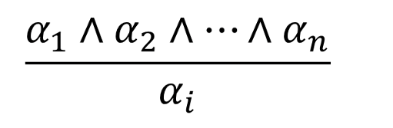
Inference Rules for Prop. Logic
And-Elimination
From conjunction, can infer any of the conjuncts

Slide 36
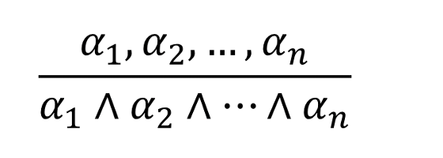
Inference Rules for Prop. Logic
And-Introduction
From list of sentences, can infer their conjunction

Slide 37
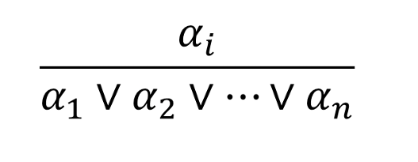
Inference Rules for Prop. Logic
Or-Introduction
From sentence, can infer its disjunction with anything else

Slide 38

Inference Rules for Prop. Logic
Double-Negation Elimination
From doubly negated sentence, can infer a positive sentence
$$\frac{¬¬α}{α}$$

Slide 39
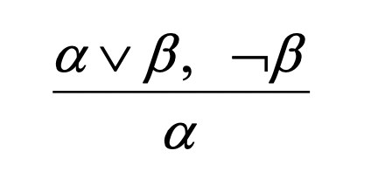
Inference Rules for Prop. Logic
Unit Resolution
From disjunction, if one of the disjuncts is false, can infer the other is true

Slide 40


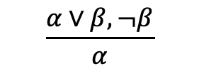



Inference Rules for Prop. Logic
Resolution
Most difficult because β cannot be both true and false
One of the other disjuncts must be true in one of the premises
(implication is transitive)
$$¬β$$
OR
$$β$$
$$\frac{α∨β, ¬β}{α}$$
OR
$$\frac{¬β∨γ, β}{γ}$$
$$α$$
OR
$$γ$$

Slide 41
First Order Logic

Slide 42
Syntax of FOL: Basic Elements
Constant symbols for specific objects
KingJohn, 2, OSU, …
Variables
x, y, a, b, …
Predicate properties (unary) / relations (pairwise or more)
Smart(), Brother(), Married(), >, …
Functions (return objects)
Sqrt() , LeftTo(), FatherOf(), …
Connectives
∧ ∨ ¬ ⇒ ⇔
Quantifiers
∀ ∃
Equality
=

Slide 43
Quantifiers
Currently have logic that allows objects
Now want to express properties of entire collections of objects
Rather than enumerate the objects by name
Two standard quantifiers
Universal ∀
Existential ∃

Slide 44
Properties of Quantifiers
Important relations
∃x P(x) = ¬∀x ¬P(x)
∀x P(x) = ¬∃x ¬P(x)
P(x) ⇒ Q(x) is same as ¬P(x) ∨ Q(x)
¬ (P(x) ∧ Q(x)) is same as ¬P(x) ∨ ¬Q(x)

Slide 45
Universal Quantifiers
∀x ∀y is same as ∀y ∀x ( ∀x,y )
∃ x ∃ y is same as ∃ y ∃ x ( ∃ x,y )
∃ x ∀y is not same as ∀y ∃ x
∃ y Person(y) ∧ (∀x Person(x) ⇒ Loves(x,y))
“There is someone who is loved by everyone”
∀x Person(x) ⇒ ∃y Person(y) ∧ Loves(x,y)
“Everybody loves somebody” (not guaranteed to be the same person)

Slide 46
How to do inference in FOPC
Reduction of first-order inference to propositional inference
First-order inference algorithms
Generalized Modus Ponens
Forward chaining ***
Backward chaining ***
Resolution-based theorem proving ***

Slide 47
Reduction to Propositional Inference
Universal Quantifiers (∀)
Recall: Sentence must be true for all objects in the world (all values of variable)
So substituting any object must be valid (Universal Instantiation, UI)
Example
∀x Person(x) ⇒ Likes(x,IceCream)
Substituting: (1), {x/Jack}
Person(Jack) ⇒ Likes(Jack,IceCream)

Slide 48
Reduction to Propositional Inference (con’t)
Existential Quantifiers (∃)
Recall: Sentence must be true for some object in the world (or objects)
Assume we know this object and give it an arbitrary (unique!) name (Existential Instantiation, EI)
Known as Skolem constant (SK1, SK2, …)
Example
∃x Person(x) ∧ Likes(x,IceCream)
Substituting: (1), {x/SK1}
Person(SK1) ∧ Likes(SK1,IceCream)
We don’t know who “SK1” is (and usually can’t), but we know they must exist

Slide 49
Reduction to Propositional Inference (con’t)
Multiple Quantifiers
No problem if same type (∀x,y or ∃x,y)
Also no problem if: ∃x ∀y
There must be some x for which the sentence is true with every possible y
Skolem constant still works (for x)
Problem with ∀x ∃y
For every possible x, there must be some y that satisfies the sentence
Could be different y value to satisfy for each x!
Solution Skolem function

Slide 50
Reduction to Propositional Inference (con’t)
Example
∀x ∃y Person(x) ⇒ Loves(x,y)
Substitute: (1), {y/SK1(x)}
∀x Person(x) ⇒ Loves(x,SK1(x))
Then: (2), {x/Jack}
Person(Jack) ⇒ Loves(Jack,SK1(Jack))
SK1(x) is effectively a function which returns a person that x loves. But, again, we can’t generally know the specific value it returns.

Slide 51
Reduction to Propositional Inference (con’t)
Internal Quantifiers
Previous rules only work if quantifiers are external (left-most)
Consider: ∀x (∃y Loves(x,y)) ⇒ Person(x)
“For all x, if there is some y that x loves, then x must be a person”
A Skolem function limits the values y could take (to one) and we can’t know what it is.
Need to move the quantifier outward
∀x (∃y Loves(x,y)) ⇒ Person(x)
∀x ¬(∃y Loves(x,y)) ∨ Person(x) (convert to ¬,∨,∧)
∀x ∀y ¬Loves(x,y) ∨ Person(x) (move ¬ inward)
∀x ∀y Loves(x,y) ⇒ Person(x)
Now we can see that we can actually substitute anything for y
May need to rename variables before moving quantifier left
Once have non-quantified sentences (from quantified sentences using UI, EI), possible to reduce first-order inference to propositional inference

Slide 52
Forward and Backward Chaining
Have language representing knowledge (FOL) and inference rules (Generalized Modus Ponens)
Now study how a reasoning program is constructed
Generalized Modus Ponens can be used in two ways:
Start with sentences in KB and generate new conclusions (forward chaining)
“Used when a new fact is added to database and want to generate its consequences” or
Start with something want to prove, find implication sentences that allow to conclude it, then attempt to establish their premises in turn (backward chaining)
“Used when there is a goal to be proved”

Slide 53
Forward Chaining
Forward chaining normally triggered by addition of new fact to KB (using TELL)
When new fact p added to KB:
For each rule such that p unifies with a premise
If the other premises are known, then add the conclusion to the KB and continue chaining
Premise: Left-hand side of implication
Or, each term of conjunction on left hand side
Conclusion: Right-hand side of implication
Forward chaining uses unification
Make two sentences (fact + premise) match by substituting variables (if possible)
Forward chaining is data-driven
Inferring properties and categories from percepts

Slide 54
Backward Chaining
Backward chaining designed to find all answers to a question posed to KB (using ASK)
When a query q is asked:
If a matching fact q’ is known, return the unifier
For each rule whose consequent q’ matches q
Attempt to prove each premise of the rule by backward chaining
Added complications
Keeping track of unifiers, avoiding infinite loops
Two versions
Find any solution
Find all solutions

Slide 55
Resolution
Uses proof by contradiction
Referred to by other names
Refutation
Reductio ad absurdum
Inference procedure using resolution
To prove P:
Assume P is FALSE
Add ¬P to KB
Prove a contradiction
Given that the KB is known to be True, we can believe that the negated goal is in fact False, meaning that the original goal must be True

